Slide 1

2.2 Le Chatelier’s Principle
Le Chatelier’s Principle
An equilibrium system subjected to a stress will shift to partially alleviate the stress and restore equilibrium.
CHEM 12
Shifts Happen

Slide 2
2.2 Le Chatelier’s Principle
How Equilibria Respond to Having Some Reactant or Product Added
How Equilibria Respond to Having Some Reactant or Product Removed
The Shift Mechanism – How Adding or Removing Some Reactant Affects the Forward Reaction Rate
The Shift Mechanism – How Adding or Removing Some Product Affects the Reverse Reaction Rate
Changing Surface Area and Adding Catalysts
The Equilibrium Position

Slide 3
2.2 Le Chatelier’s Principle
How Equilibria Respond to Having Some Reactant or Product Added
When a quantity of reactant or product is added to an equilibrium system, it will shift to remove some of the added chemical.

Slide 4
2.2 Le Chatelier’s Principle
How Equilibria Respond to Having Some Reactant or Product Removed
When a quantity of reactant or product is removed to an equilibrium system, it will shift to replace some of the removed chemical.

Slide 5
2.2 Le Chatelier’s Principle
The Shift Mechanism – How Adding or Removing Some Reactant Affects the Forward Reaction Rate
To an equilibrium system, a stress is any action that has a different effect on the forward reaction rate than it does on the reverse reaction rate thus disrupting the equilibrium.
Adding some reactant increases the forward reaction rate.
Removing some reactant decreases the forward reaction rate.

Slide 6
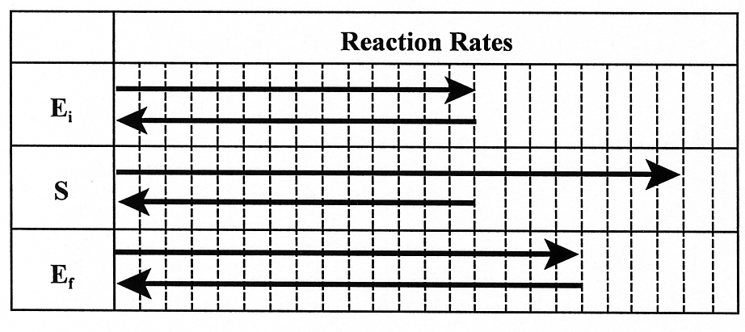
2.2 Le Chatelier’s Principle
The Shift Mechanism – How Adding or Removing Some Reactant Affects the Forward Reaction Rate
Arrow Diagrams show how the forward and reverse rates are affected by a stress. What was the stress here?

Slide 7
2.2 Le Chatelier’s Principle
The Shift Mechanism – How Adding or Removing Some Product Affects the Reverse Reaction Rate
Adding some product increases the reverse reaction rate.
Removing some product decreases the reverse reaction rate.

Slide 8
2.2 Le Chatelier’s Principle
Changing Surface Area and Adding Catalysts
In heterogeneous reactions, an increase in surface area increases the forward and reverse rates equally and therefore the equilibrium system doesn’t shift.
Likewise, adding a catalyst increases the forward and reverse rates equally and therefore the equilibrium system doesn’t shift.

Slide 9
2.2 Le Chatelier’s Principle
The Equilibrium Position
The phrase ‘equilibrium position’ refers to the relative concentrations of reactants and products at equilibrium. Products are favoured when the equilibrium has a greater than 50 percent yield.
It is important to make a distinction between the equilibrium system shifting in response to a stress (as described by Le Chatelier’s principle) and the equilibrium position shifting as a possible result.
You can’t infer that any one reactant or product necessarily has a higher or lower concentration than another solely from the products being favoured.

